Slide 1
HOW IN THE WORLD
CAN I POSSIBLY WRITE
A FAMILY HISTORY BOOK?
“GCSGA” Meeting, July 11, 2015
Presented by Bob Volz

Slide 2
A QUESTION FOR THE GROUP
HOW MANY OF YOU HAVE THOUGHT ABOUT WRITING SOME OF YOUR LIFE OR FAMILY STORIES AND EXPERIENCES AND DON’T KNOW WHERE TO START?
A SHOW OF HANDS PLEASE!

Slide 3
THINKING about WRITING your FAMILY HISTORY in a “some” FORMAT
You have to start somewhere! Start with the
information from your tree. How many of you here today are beginners?
As a beginner, gather as much Information about your ancestors prior to seeking out a database. Where your ancestors originated from, whether it was Ireland, Germany, Poland and where they arrived, the US or Canada could influence which database you wish to join. Not all databases are created equal. Investigate the resources a database offers you in terms of your specific needs.
If somewhat experienced, then you should have at hand what I mentioned in the prior bullet point.

Slide 4
THINKING about WRITING your FAMILY HISTORY in a “some” FORMAT
Consider how much money you are willing to spend if any.
I am personally a big fan of Ancestry. However, Ancestry is an investment in your genealogy. If you do not wish to make that kind of investment then you may want to consider Family Search, a free database.
There are also plenty of smaller databases, specializing in specific countries.
Take them for a trial run. Many databases offer free 7 day subscriptions, which will provide you an opportunity to get into the documents and make sure they are the right fit for you.

Slide 5
THINKING about WRITING your FAMILY HISTORY in a “some” FORMAT
However, you do not have to make a long-term commitment to any database. Depending on the database, you can subscribe for a limited time. Some other databases will charge you by the document.
  There are many smaller databases, they offer you records that are more specific, such as newspaper databases, cemetery databases and passenger lists, and they are great as an add-on to a main database. However, you should make yourself familiar with the major online genealogy databases if you are new to doing family research. Here are the bigger players to investigate to get you started. Keeping in mind, the above tips to determine which database is the best fit for your genealogy research.
  BEST EXAMPLES: Ancestry.com & Family Search.org

Slide 6
BEFORE I START, NOW WHAT????
THINK OF WRITING “THE STORY” AS A LIFE STORY.
  IF IT IS MY LIFE, THEN I NEED TO START WITH MY BIRTH AND GO FORWARD.
  THE BEST HELPFUL TOOL WOULD BE A LISTING OF YEARLY EVENTS, INCLUDING TIME LINES OF EVENTS.
  WHAT DO I KNOW ABOUT MYSELF, FAMILY LIFE AND HISTORY THAT FITS INTO EACH YEAR? IS IT ORGANIZED?
  DON’T MANUFACTURE BUT LIST ONLY FACTUAL EVENTS AS BEST YOU CAN RECALL OR FIND THROUGH RESEARCH.
  BE ACCURATE BY OBSERVING THE NATURAL ORDER OF EVENTS IN YOUR LIFE TO PRESENT DAY!
  BE DECISIVE, QUOTE EXACTLY, AVOID CLICHES.
  EACH PARAGRAPH SHOULD HAVE MATERIAL RELATING TO THAT SPECIFIC TIME PERIOD.
  REMEMBER THE KEY TO SUCCESSFUL WRITING IS READABILITY. SELECT THE BEST DETAILS TO MOVE THE STORY ALONG. USE THE WOW FACTOR!

Slide 7
HOW DO I DO IT? WHAT SHOULD I CONSIDER?
KEY POINTS TO CONSIDER
Determine the SCOPE of WORK. It would be impossible to write one book that covered everything you know from your research. Instead, decide on a specific scope of work for your project. The more clearly you determine what you’re trying to accomplish, the easier it will be write out your narrative. Keep it simple and stay organized!
Some examples to ask yourself: Who will be my target audience? Is this book for me, my immediate family or for the public, i.e., for a historical society or a library? Remember, you are the storyteller.
Your FAMILY HISTORY should be INFORMATIVE, ENGAGING and ENTERTAINING.

Slide 8
HOW DO I DO IT? WHAT SHOULD I CONSIDER?
Do I want to trace one surname completely or several connected families in that line? Or do I want to try to do multiple family lines?
  Tracing one surname fully will mean researching all branches or one branch from a particular ancestor to the present (or a time frame you choose).
  If your choice is to do many connected lines, you will probably limit how many descendants to include. This is not recommended by our group. A book dedicated to all related surnames will be the most limited in what is included as to descendants.
  Remember to take into account the size you want your book to be, not making it too large to be read and be used.

Slide 9
HOW DO I DO IT? WHAT SHOULD I CONSIDER?
OTHER QUESTIONS TO PONDER……
What about my time frame? On a given Sur Name, do I use from old country to present or from immigration, etc., or just a certain time period?
Do I want an entire history or just from where I found them in the States or the Old Country? I must make a decision on this!
You don’t have to write a large narrative on each person. Short, sweet and to the point.
You can write even if you are still researching. Don’t make a habit of this.

Slide 10
WHAT ELSE SHOULD BE CONSIDERED?
Besides my family group records, what else should be included? Remember we have been schooled many times that a family history doesn’t become a “HISTORY” without stories which in essence make our ancestors come to life again. An example to get your thinking straight would be to ask yourself “What was the world or place like where my ancestor lived?” What did he/she do (occupation, religion, status-property owner). Can you tie in an historical event even though it didn’t touch your ancestor? Do you have any letters that tie into this time period from an ancestor or a document? How about photos, maps of land ownership, descriptions of his/her homestead, etc.

Slide 11
WHAT ELSE SHOULD BE CONSIDERED?
Think about creating an ANCESTOR PROFILE on your most important relatives. A profile should be considered as a character sketch. By starting small you won’t become overwhelmed. Just think of this type of profile as a snapshot in time of your ancestor’s life.
What ELEMENTS should be contained in this PROFILE? A GOOD STORY; A description with key details; Dialogue if available (a recording is best to gain incite); Showing what the person was like. REMEMBER, THIS PROFILE IS “SHOW”, DON’T TELL! You can use documents, cemetery stone stories, interviews, newspaper articles, diaries and letters and of course your memories (stated as such). Also, use ACTION VERBS whenever possible.
DO NOT EDIT AS YOU WRITE.

Slide 12
THE LOGISTICS OF YOUR BOOK
THINGS THAT MUST BE INCLUDED FOR YOUR BOOK TO BE USEFUL:
TABLE OF CONTENTS
INDEX (very important to list every person mentioned in your book. Also list on what page or pages they appear).
BIBLIOGRAPHY ( include the names of books and materials used in your research).
DOCUMENTATION (incorporate all of your sources of information, i.e., photos, oral histories, etc.).
ORGANIZATION ( keep your families within their generational period and surname category).
Numbering system for ancestors There are many systems out there, but pick one that works for you. This is real important for a single surname book.
FOOTNOTES must be used (see the next slide).

Slide 13
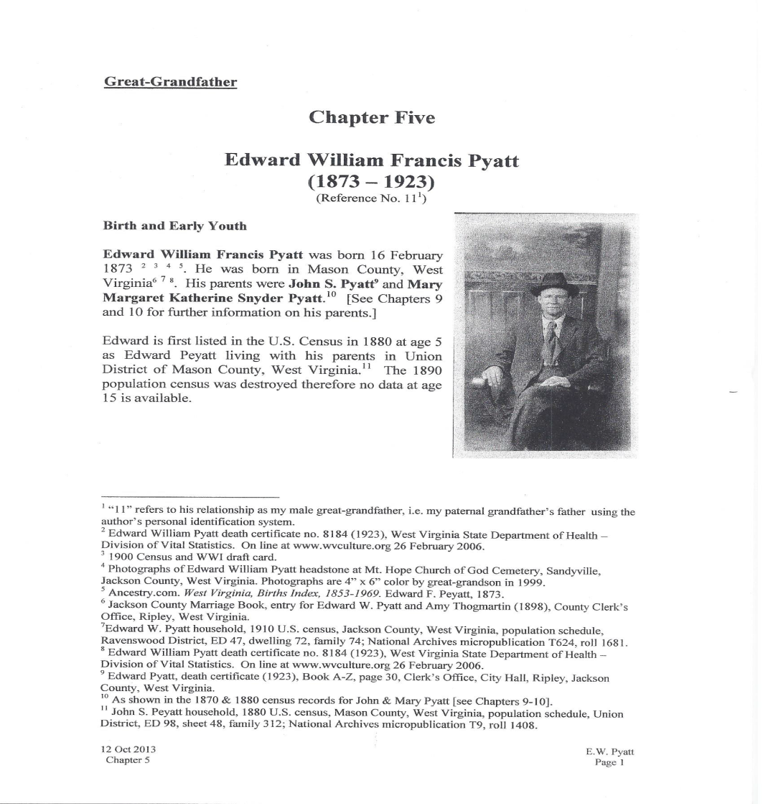
EXAMPLE OF FOOTNOTE USAGE
FROM TERRY MANNING’s “Genealogy Study Group”, Lawrencevill e, GA.

Slide 14
FINAL THOUGHTS
A REMINDER: GENEALOGY IS A NEVER ENDING HISTORY OF FAMILIES AND THEIR LIVES. NEW INFORMATION IS BEING ADDED DAILY TO THE MAJOR WEB SITES. YOU MUST CHECK THEM OFTEN!
Facts must be documented.
Suppositions and guesses are just that and can’t be documented. If you use any of these, be sure to say it was a guess.
A family story is just a story until there is proof to back it up, so be sure you differentiate the difference clearly.
Edit your work at the end to prevent future embarrassment. Expect to spend as much time on this as you did writing the story.

Slide 15
FINAL THOUGHTS CONTINUED
Writing your FAMILY HISTORY can be a great way to capture all the information that you’ve worked on in your genealogical research. It is also a way to convey the story of your family’s development over time in an easy way for all to understand.
Consider working with a PROFESSIONAL (budget permitting). Writing is a major undertaking. Consulting with a professional genealogist might help you make important choices about what to cover. An EDITOR can proofread the document to insure the work is error free.
Publish (Appearance and quality will depend on your budget). Selection of a publisher also is determined by the quality of your work and budget. For assistance, GOOGLE “Book Publishers in Georgia”.

Slide 16
OTHER THINGS TO CONTEMPLATE AND LEARN FROM!
How about taking a course in Family History Writing. Check to see if you can find a writer’s online workshop or check with your local adult education or community colleges to see if they offer courses.
Suggested Writing Guidebooks:
  “Bringing Your Family History to Life through Social History” by Katherine Scott Sturdevant (Betterway Books)
  Writing Family Histories and Memories by Kirk Polking (Writer’s Digest Books)
  Writing the Family Narrative by Lawrence P. Goldrup (Ancestry)
  For All Time: A Complete Guide to Writing Your Family History (Heinemann)
  Authentic Ancestors workbook by Lynn Palermo – site - http://genealogyalacarte.ca/?p=7225

Slide 17
OTHER THINGS TO CONTEMPLATE AND LEARN FROM!
ARTICLES:
Writing Tips: How to Come Up With 50 Topic Ideas in 30 Minutes. http://www.entrepreneur.com/article/234238
Writing Routines that Work. http://www.writersdigest.com/editor-blogs/guide-to-literary-agents/7-writing-routines-that-work
Creating Dialogue in Nonfiction About the Past http://www.storiestotellbooks.com/blog/2012/7/10/creating-dialogue-in-nonfiction-about-the-past.html

Slide 18
WHAT SOFTWARE SHOULD YOU USE FOR YOUR BOOK?
This is NOT A COP OUT, but we cannot suggest one brand over another. The choice is really a personal one (cost, ease of use, etc.). Again, we suggest that you GOOGLE “Best Software to Use in Book Writing”. You will get lots of suggestions. Then ask around as there are blogs that will give you their opinion on their use of certain softwares.

Slide 19
THANK YOU FOR YOUR ATTENTION AND GOOD WRITING TO ALL GOING FORWARD
All rights reserved – copywriter Bob Volz, July 11, 2015

